Slide 1
CS3210 Tut 5
MPI & Performance of Heterogeneous CPU
Slides edited from Zhi Heng's / inspired from Sriram
+ extra tidbits

Slide 2
Today's topics
MPI communication: in a "logical ring" and avoiding deadlocks
Using these ideas to do pipelined computation
Separate: what happens to performance when we use heterogeneous hardware?

Slide 3
Q1

Slide 4
Logical Ring Communication
int rank, p, size = 8;
int left, right ;
char send_buffer1[8], recv_buffer1[8];
char send_buffer2[8], recv_buffer2[8];
...
MPI_Comm_rank(MPI_COMM_WORLD, &rank)
MPI_Comm_size(MPI_COMM_WORLD, &p)
left = (rank - 1 + p) % p ;
right = (rank + 1) % p ;
...
MPI_Send (send_buffer1, size, MPI_CHAR, left , ...);
MPI_Recv (recv_buffer1, size, MPI_CHAR, right , ...);
MPI_Send (send_buffer2, size, MPI_CHAR, right , ...);
MPI_Recv (recv_buffer2, size, MPI_CHAR, left , ...);
...
Question: Assign a unique name to each MPI process and fill out the missing pieces of the program such that each process prints its own name as well as it neighbors’ names.

Slide 5
Logical Ring Communication
int rank, p, size = 8;
int left, right ;
char send_buffer1[8], recv_buffer1[8];
char send_buffer2[8], recv_buffer2[8];
...
MPI_Comm_rank(MPI_COMM_WORLD, &rank)
MPI_Comm_size(MPI_COMM_WORLD, &p)
left = (rank - 1 + p) % p ;
right = (rank + 1) % p ;
...
MPI_Send (send_buffer1, size, MPI_CHAR, left , ...);
MPI_Recv (recv_buffer1, size, MPI_CHAR, right , ...);
MPI_Send (send_buffer2, size, MPI_CHAR, right , ...);
MPI_Recv (recv_buffer2, size, MPI_CHAR, left , ...);
...
(a) How can each process get a unique name?

Slide 6
Logical Ring Communication
int rank, p, size = 8;
int left, right ;
char send_buffer1[8], recv_buffer1[8];
char send_buffer2[8], recv_buffer2[8];
gethostname(send_buffer1, size) //repeat for buffer2
...
MPI_Comm_rank(MPI_COMM_WORLD, &rank)
MPI_Comm_size(MPI_COMM_WORLD, &p)
left = (rank - 1 + p) % p ;
right = (rank + 1) % p ;
...
MPI_Send (send_buffer1, size, MPI_CHAR, left , ...);
MPI_Recv (recv_buffer1, size, MPI_CHAR, right , ...);
MPI_Send (send_buffer2, size, MPI_CHAR, right , ...);
MPI_Recv (recv_buffer2, size, MPI_CHAR, left , ...);
...
If there are two processes on the same node: sprintf(send_buffer1, “rank %d”, …, rank)
How about finishing up the Sends & Recvs?
Note: you might want to use MPI_Get_processor_name() instead of gethostname()
https://stackoverflow.com/questions/22174901/gethostname-function-missing-in-openmpi

Slide 7
Logical Ring Communication
int rank, p, size = 8;
int left, right ;
char send_buffer1[8], recv_buffer1[8];
char send_buffer2[8], recv_buffer2[8];
gethostname(send_buffer1, size) //repeat for buffer2
...
MPI_Comm_rank(MPI_COMM_WORLD, &rank)
MPI_Comm_size(MPI_COMM_WORLD, &p)
left = (rank - 1 + p) % p ;
right = (rank + 1) % p ;
...
MPI_Send (send_buffer1, size, MPI_CHAR, left , TAG_LEFT, MPI_COMM_WORLD);
MPI_Recv (recv_buffer1, size, MPI_CHAR, right , TAG_LEFT, MPI_COMM_WORLD, MPI_STATUS_IGNORE);
MPI_Send (send_buffer2, size, MPI_CHAR, right , TAG_RIGHT, MPI_COMM_WORLD);
MPI_Recv (recv_buffer2, size, MPI_CHAR, left , TAG_RIGHT, MPI_COMM_WORLD, MPI_STATUS_IGNORE);
printf(“my name: %s; left: %s; right: %s\ n”, send_buffer1, recv_buffer1 , recv_buffer2); // or cout
Assume TAG_LEFT and TAG_RIGHT tags are assumed distinct values.

Slide 8
Let's try to run it!
vim q1a.c
mpirun -np 4 ./q1a | sort
salloc -n 4 -N 4 mpirun ./q1a | sort

Slide 9
Something like a classic synchronization problem?
MPI_Send left MPI_Recv right MPI_Send right MPI_Recv left

Slide 10
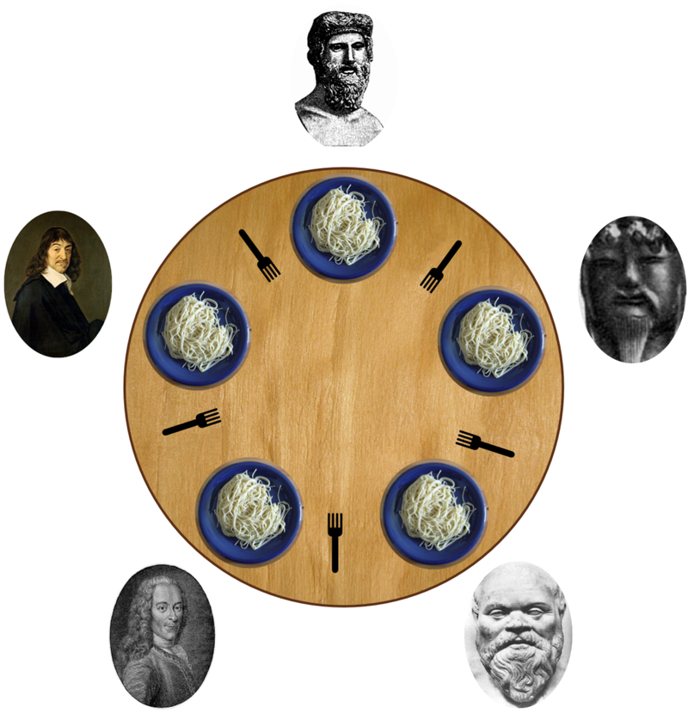
Something like a classic synchronization problem?
MPI_Send left MPI_Recv right MPI_Send right MPI_Recv left
Maybe dining philosophers?
Processes are "chopsticks"
They can only be sending or receiving messages at any point of time but not both
Messages are "philosophers"
Requires a sending end and receiving end to be processed (i.e. 2 chopsticks)

Slide 11
Something like a classic synchronization problem?
This will happen if MPI_Send is not buffered.
If all processes send to left neighbour, messages all have sending ends but do not have receiving ends.
Deadlock!

Slide 12
Deadlock showcase
Using a larger message size (200000 bytes) to ensure MPI_Send is not buffered
vim q1b.c
salloc -n 4 -N 1 mpirun ./q1b

Slide 13
How do we fix this?
MPI_Send ( send_buffer1, size, MPI_CHAR, left , ...);
MPI_Recv ( recv_buffer1, size, MPI_CHAR, right , ...);
MPI_Send ( send_buffer2, size, MPI_CHAR, right , ...);
MPI_Recv ( recv_buffer2, size, MPI_CHAR, left , ...);

Slide 14
How do we fix this? Even-odd solution
if (rank % 2 == 0) {
// send before recv
MPI_Send ( send_buffer1, size, MPI_CHAR, left , ...);
MPI_Recv ( recv_buffer1, size, MPI_CHAR, right , ...);
MPI_Send ( send_buffer2, size, MPI_CHAR, right , ...);
MPI_Recv ( recv_buffer2, size, MPI_CHAR, left , ...);
} else {
// recv before send
MPI_Recv ( recv_buffer1, size, MPI_CHAR, right , ...);
MPI_Send ( send_buffer1, size, MPI_CHAR, left , ...);
MPI_Recv ( recv_buffer2, size, MPI_CHAR, left , ...);
MPI_Send ( send_buffer2, size, MPI_CHAR, right , ...);
}

Slide 15
Let's try it!
vim q1c.c
salloc -n 4 -N 1 mpirun ./q1c

Slide 16
Right-handed philosopher solution
One of the philosophers (processes) will receive from the right side first
This resolves the deadlock as there is always someone ready to receive

Slide 17
How do we fix this? Right-handed philosopher
if (rank < size - 1) { // All except the last rank sends normally
MPI_Send ( send_buffer1, size, MPI_CHAR, left , ...);
MPI_Recv ( recv_buffer1, size, MPI_CHAR, right , ...);
MPI_Send ( send_buffer2, size, MPI_CHAR, right , ...);
MPI_Recv ( recv_buffer2, size, MPI_CHAR, left , ...);
} else { // This is executed only by the last rank
MPI_Recv ( recv_buffer1, size, MPI_CHAR, right , ...);
MPI_Send ( send_buffer1, size, MPI_CHAR, left , ...);
MPI_Recv ( recv_buffer2, size, MPI_CHAR, left , ...);
MPI_Send ( send_buffer2, size, MPI_CHAR, right , ...);
}

Slide 18
Which solution is likely to be faster?
Even-odd
Can complete in 4 “rounds” of communication
Even send, odd receive → Even receive, odd send (left) → repeat these steps for the right-wise send
Right-handed
Everyone except one rank sends to the right but is blocked
Last rank receives and unblocks second-last rank to receive
Repeat.. takes far more steps

Slide 19
Logical Ring Communication
int rank, p, size = 8;
int left, right ;
char send_buffer1[8], recv_buffer1[8];
char send_buffer2[8], recv_buffer2[8];
gethostname(send_buffer1, size) //repeat for buffer2
...
MPI_Comm_rank(MPI_COMM_WORLD, &rank)
MPI_Comm_size(MPI_COMM_WORLD, &p)
left = (rank - 1 + p) % p ;
right = (rank + 1) % p ;
...
MPI_Send (send_buffer1, size, MPI_CHAR, left , ...);
MPI_Recv (recv_buffer1, size, MPI_CHAR, right , ...);
MPI_Send (send_buffer2, size, MPI_CHAR, right , ...);
MPI_Recv (recv_buffer2, size, MPI_CHAR, left , ...);
printf(“my name: %s; left: %s; right: %s\ n”, send_buffer1, recv_buffer1 , recv_buffer2); // or cout
What if we use ISend and IRecv? How do we write it?

Slide 20
Logical Ring Communication
int rank, p, size = 8;
int left, right ;
char send_buffer1[8], recv_buffer1[8];
char send_buffer2[8], recv_buffer2[8];
gethostname(send_buffer1, size) //repeat for buffer2
...
MPI_Comm_rank(MPI_COMM_WORLD, &rank)
MPI_Comm_size(MPI_COMM_WORLD, &p)
left = (rank - 1 + p) % p ;
right = (rank + 1) % p ;
MPI_Request reqs[4]; MPI_Status stats[4];
MPI_ISend (send_buffer1, size, MPI_CHAR, left , TAG_LEFT, MPI_COMM_WORLD, &reqs[0]);
MPI_IRecv (recv_buffer1, size, MPI_CHAR, right , TAG_LEFT, MPI_COMM_WORLD, MPI_STATUS_IGNORE, &reqs[1]);
MPI_ISend (send_buffer2, size, MPI_CHAR, right , TAG_RIGHT, MPI_COMM_WORLD, &reqs[2]);
MPI_IRecv (recv_buffer2, size, MPI_CHAR, left , TAG_RIGHT, MPI_COMM_WORLD, &reqs[3]);
MPI_Waitall(4, reqs, stats);
printf(“my name: %s; left: %s; right: %s\ n”, send_buffer1, recv_buffer1 , recv_buffer2); // or cout
What if we use ISend and IRecv? How do we write it?

Slide 21
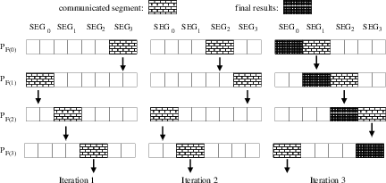
Why does this question matter?
Logical ring (or generalized more to Cartesian grid) layouts are useful for many problems (simulations, array ops, etc)
Looks like a pipeline: but also comes with synchro issues since it’s not just unidirectional

Slide 22
Q2

Slide 23
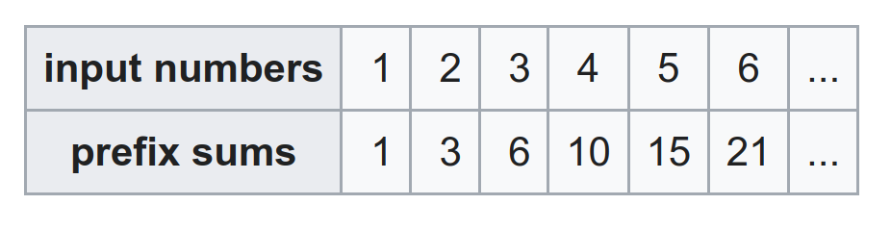
Q2: Prefix Sums
Each element in the prefix sum output is the running total of all input numbers up to that index.
E.g. 6 = 1 + 2 + 3
How can we design a pipelined MPI program to do this?

Slide 24
Q2: Prefix Sums
How can we design a pipelined MPI program to do this?
Scatter the input array to all ranks
Rank 1
Rank 2
Rank N
…
1
2
N

Slide 25
Q2: Prefix Sums
How can we design a pipelined MPI program to do this?
Scatter the input array to all ranks
Each rank gets the prefix sums so far from prev rank and adds its own number to produce the next sum (recv → add → send)
Rank 1
Rank 2
Rank N
…
1
2
N

Slide 26
Let's try it!
vim q2.c
salloc -n 4 -N 1 mpirun ./q2_4
salloc -n 200 -N 1 --overcommit mpirun ./q2

Slide 27
Q2: Prefix Sums
What is the maximum theoretical speedup if we have to process an infinite number of size N arrays?
In a magical world: theoretical pipeline speedup limit is N
Not remotely possible with communication delays >> computation like this!
Rank 1
Rank 2
Rank N
…
1
2
N

Slide 28
Q2: Prefix Sums
What if we can use MPI_Scan?
Rank 1
Rank 2
Rank N
…
1
2
N

Slide 29
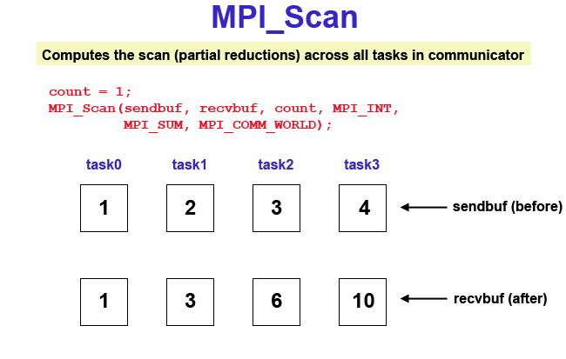
Q2: Prefix Sums
What if we can use MPI_Scan?
Same, must scatter first, then…
Call MPI_Scan with input and output arrays. Any limitations?
Rank 1
Rank 2
Rank N
…
1
2
N
1
3
…

Slide 30
Q2: Prefix Sums
Any limitations?
MPI_Scan results are left in the indiv ranks, need to MPI_Gather the results for printing!
MPI_Scan is not pipelineable! It must complete the computation of an entire prefix sum first.
Rank 1
Rank 2
Rank N
…
1
2
N
1
3
…

Slide 31
Let's try it!
salloc -n 200 -N 1 --overcommit /usr/bin/time -vvv mpirun ./q2_noprint
How long will the MPI_Scan version take?
salloc -n 200 -N 1 --overcommit /usr/bin/time -vvv mpirun ./q2_scan
How long do you think the serial version will take?
time ./q2_serial

Slide 32
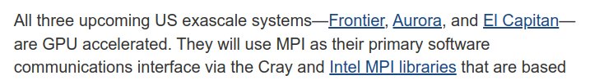

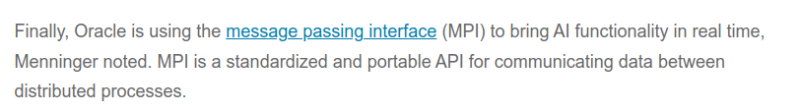
Why does this question matter?
These “toy” examples are clearly not faster than just running things on a single node (with threads at best)
However, most significant high-performance computing uses MPI to solve such problems → scale makes this much better!

Slide 33
Q3

Slide 34

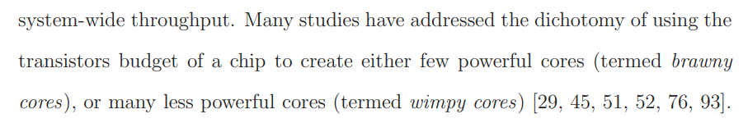
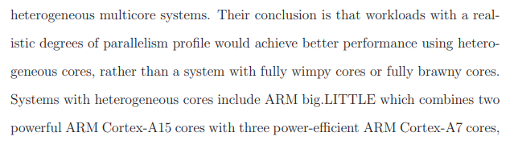
“Wimpy” and “Brawny”: A Research Success?
Many theoretical works “back in the day” really looked into this, but few implementations in reality…(?)

Slide 35

Extra: CS3210 lore
Notes:
if you know, you know.

Slide 36
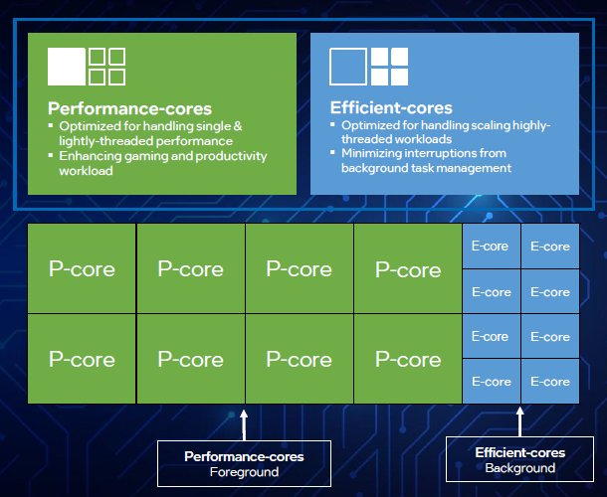
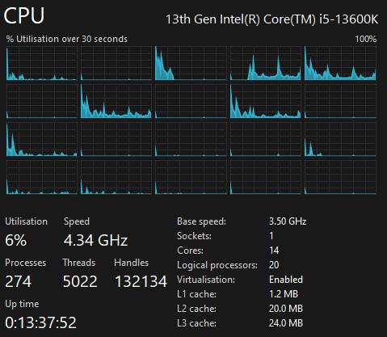
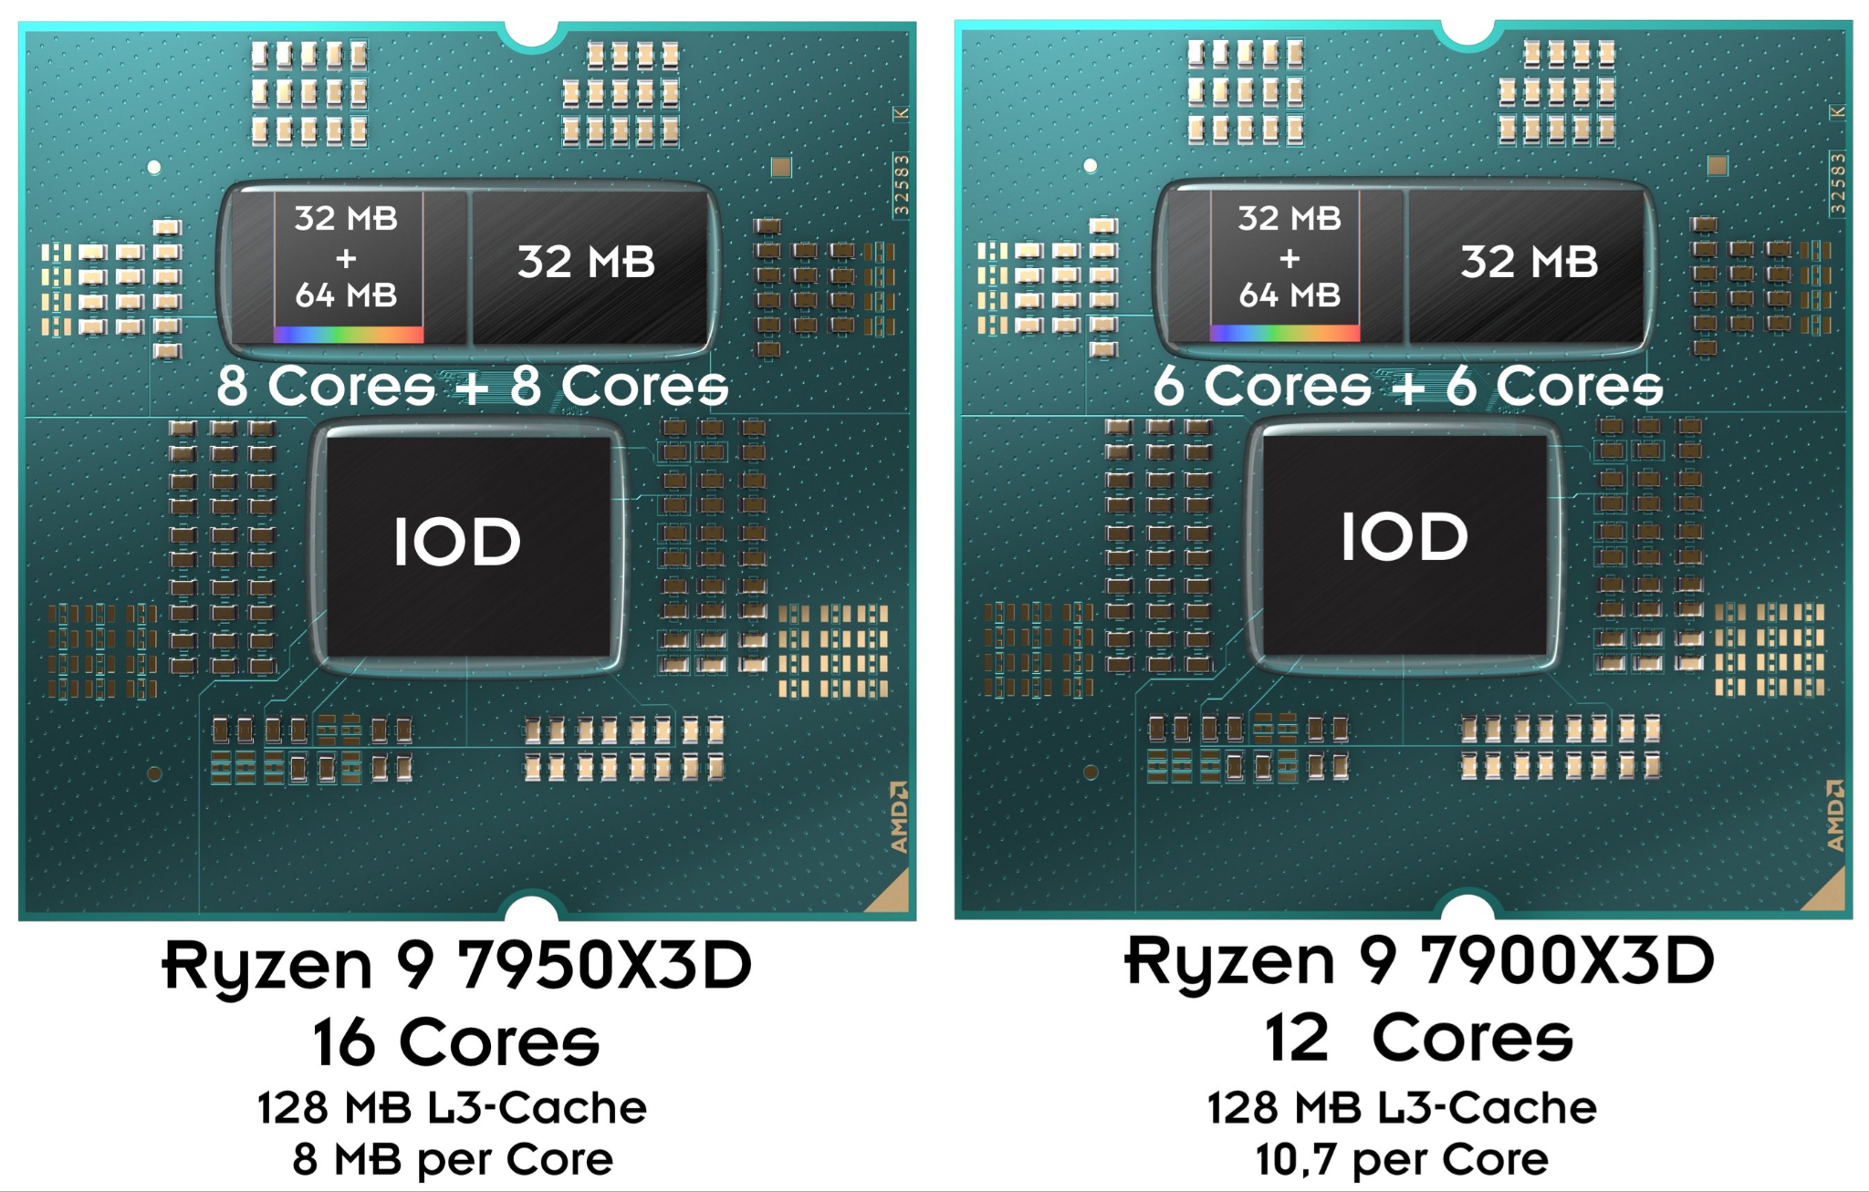
“Wimpy” and “Brawny”: A Research Success!
Back then: ARM big.LITTLE (mostly used in phones)
Now
Intel Alder Lake/Raptor Lake/Arrow Lake (2 types of processing cores w/ differing instruction sets, clock speeds, L1+L2 cache & Hyperthreading)
AMD Ryzen 7900X3D, 7950X3D (2 types of chiplets, comprising of processing cores that differ in L3 cache size and clock speed)

Slide 37
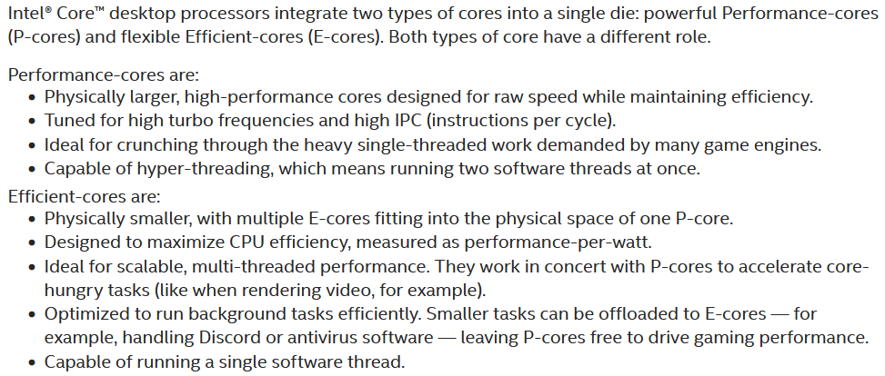
“Wimpy” and “Brawny”: A Research Success!
https://www.intel.com/content/www/us/en/gaming/resources/how-hybrid-design-works.html

Slide 38
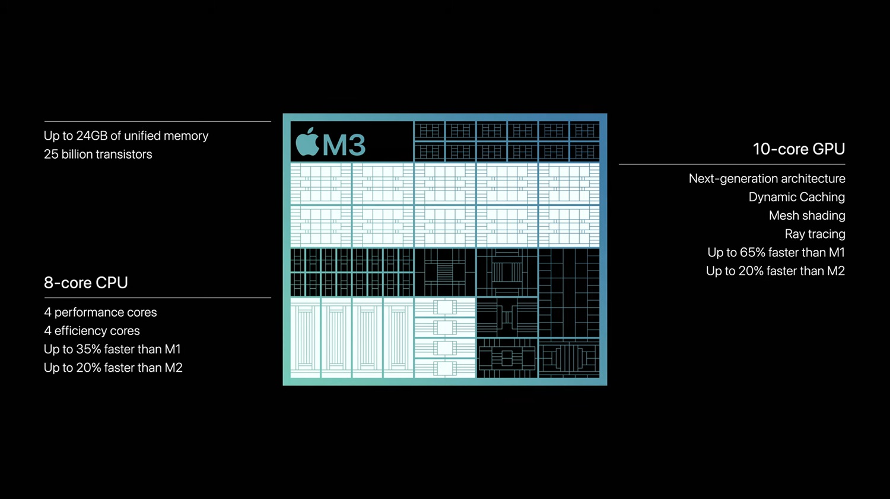
“Wimpy” and “Brawny”: A Research Success!
Notes:
don't mind me, i love following hardware trends

Slide 39
The Setup
You have to decide between 3 designs for a processor
Brawny cores are 2x as fast and use 4x more power than Wimpy ones
You only care about a benchmark with parallelizable fraction f, serial cannot overlap with parallel, parallel portion can get linear speedup
Design 1
Design 2
Design 3
Benchmark
Serial
(1 - f)
Parallelizable
f
Wimpy
Wimpy
Wimpy
Brawny
Brawny
Wimpy
Wimpy
Wimpy
Wimpy
Wimpy
Wimpy
Wimpy
Wimpy
Wimpy
Single wimpy: Benchmark takes 200s
Wimpy
Wimpy
Wimpy
Brawny
Brawny
Brawny
Brawny
Wimpy
Wimpy
Wimpy
Single brawny:
Benchmark takes 100s

Slide 40
Q3a
What is the time taken for a system w/ N_{wimpy} cores & parallelizable fraction f?
Design 1
Benchmark
Serial
(1 - f)
Parallelizable
f
Wimpy
Wimpy
Wimpy
Wimpy
Wimpy
Wimpy
Single wimpy: Benchmark takes 200s
Wimpy
Wimpy
Wimpy
Wimpy
Wimpy
Wimpy
Single brawny:
Benchmark takes 100s

Slide 41
Q3a
What is the time taken for a system w/ N_{wimpy} cores & parallelizable fraction f?
Serial Part: 200(1-f) Parallel part: 200f/N_{wimpy} Total = 200(1-f) + 200f / N_{wimpy} = 200((1-f) + (f/N_{wimpy}))
Design 1
Benchmark
Serial
(1 - f)
Parallelizable
f
Wimpy
Wimpy
Wimpy
Wimpy
Wimpy
Wimpy
Single wimpy: Benchmark takes 200s
Wimpy
Wimpy
Wimpy
Wimpy
Wimpy
Wimpy
Single brawny:
Benchmark takes 100s

Slide 42

Q3b
What is the time taken for a system w/ N_{wimpy} cores, N_{brawny} cores and parallelizable fraction f?
Benchmark
Serial
(1 - f)
Parallelizable
f
Wimpy
Wimpy
Wimpy
Wimpy
Wimpy
Wimpy
Single wimpy: Benchmark takes 200s
Bonus: this primary school question
Brawny
Brawny
Single brawny:
Benchmark takes 100s

Slide 43
Q3b
What is the time taken for a system w/ N_{wimpy} cores, N_{brawny} cores and parallelizable fraction f?
Serial part: 100(1-f) → We use brawny core for this!
For parallel: We want to use brawny and wimpy cores to finish at the same time, so allocate each brawny 2x the work of a wimpy
Parallel is: 200f / (2N_{brawny}+N_{wimpy})
Sum serial + parallel to get total time
Serial
(1 - f)
Parallelizable
f
Wimpy
Wimpy
Wimpy
Wimpy
Wimpy
Wimpy
Single wimpy: Benchmark takes 200s
Brawny
Brawny
Single brawny:
Benchmark takes 100s

Slide 44
Q3c: Energy - Speed Tradeoff
Skipping towards the final results; calculations should be trivial.
20 wimpy: 200J of energy and runs in 29 seconds
5 brawny: 400J of energy and runs in 28 seconds
4 wimpy + 4 brawny: 340J of energy and runs in 25 seconds

Slide 45
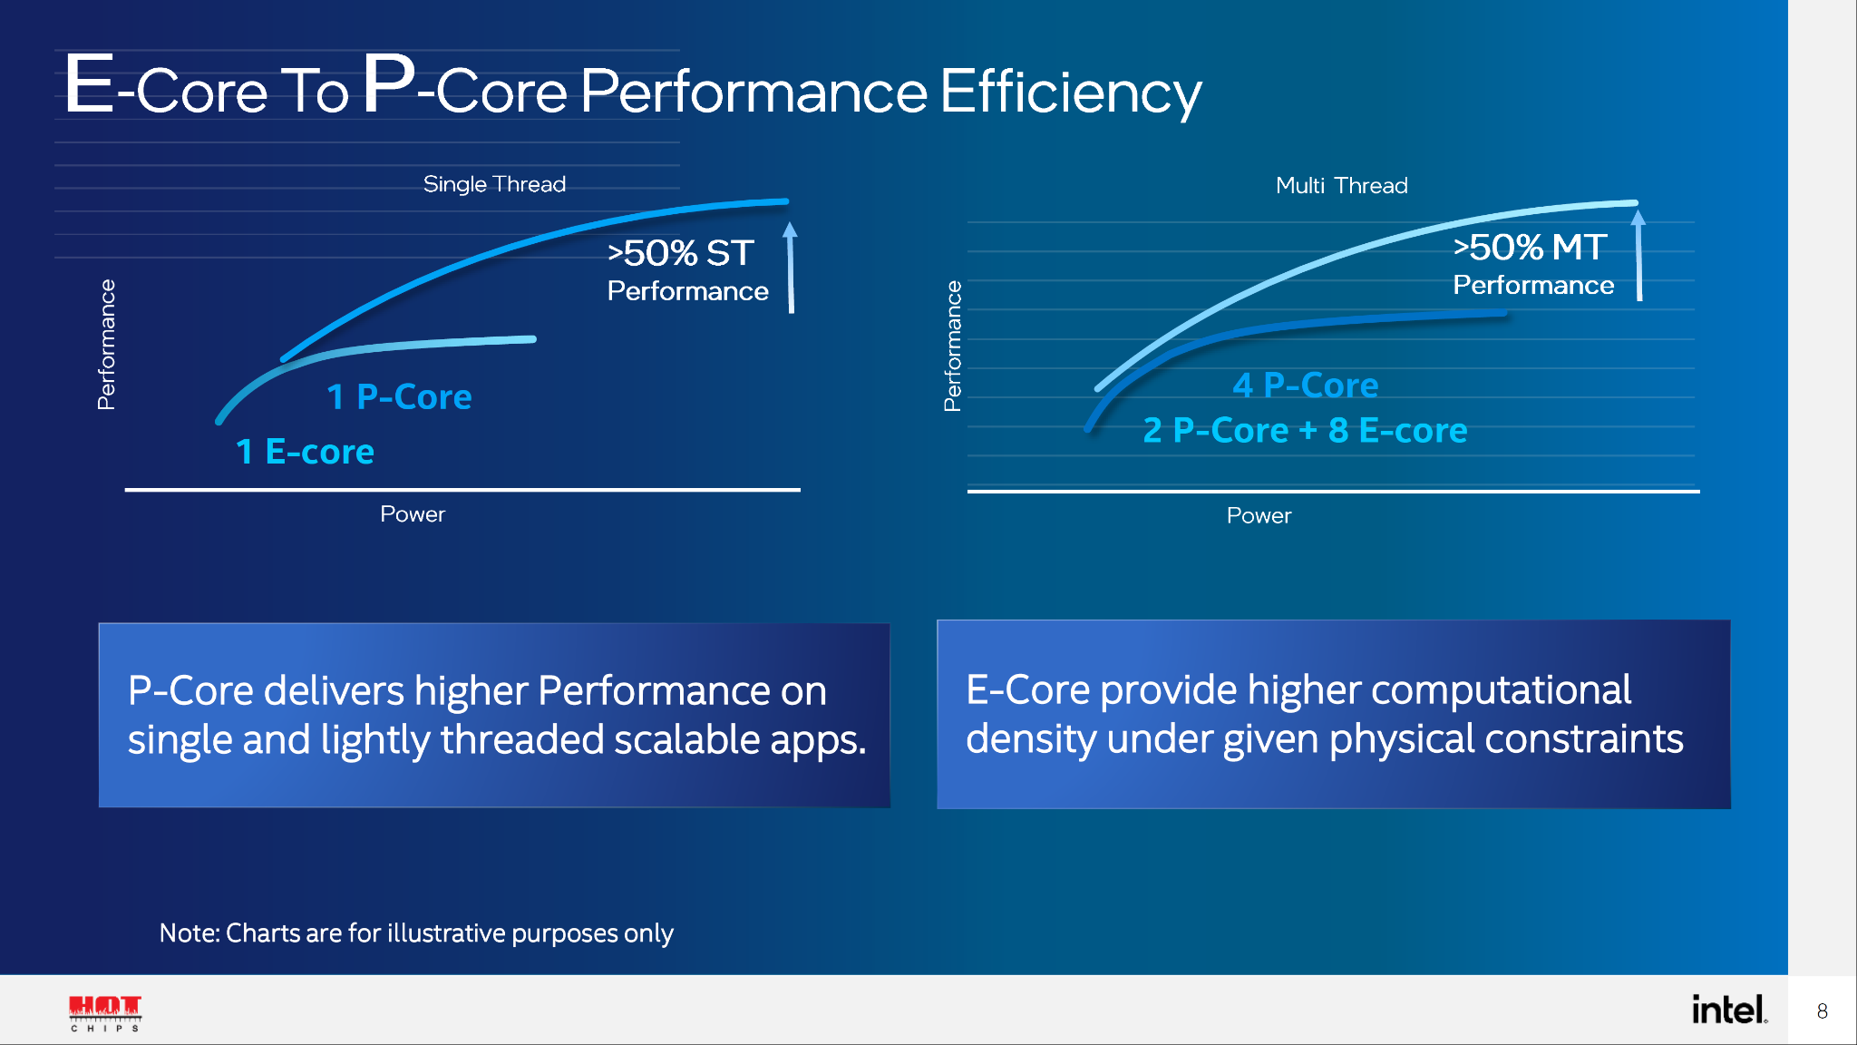
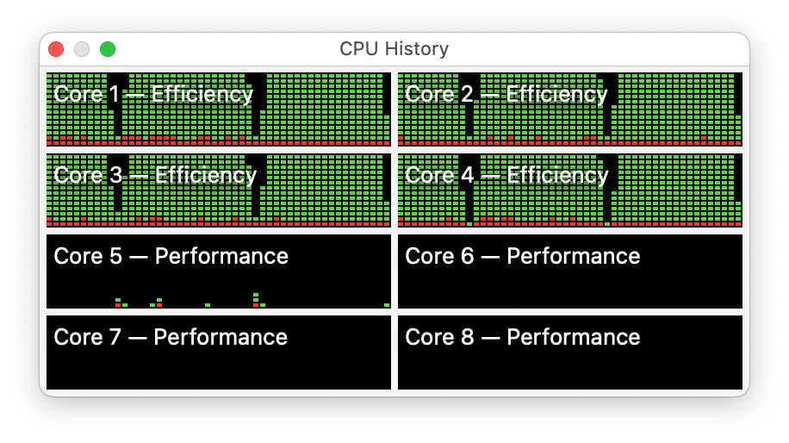
Why does this question matter?
Looks like a new golden era of heterogenous cores!
Single-threaded performance: “Brawny” / “P-Cores”
Multi-threaded performance per watt: “Wimpy” / “E-Cores”
Wimpy cores use less power per unit performance

Slide 46
Assignment 3

Slide 47
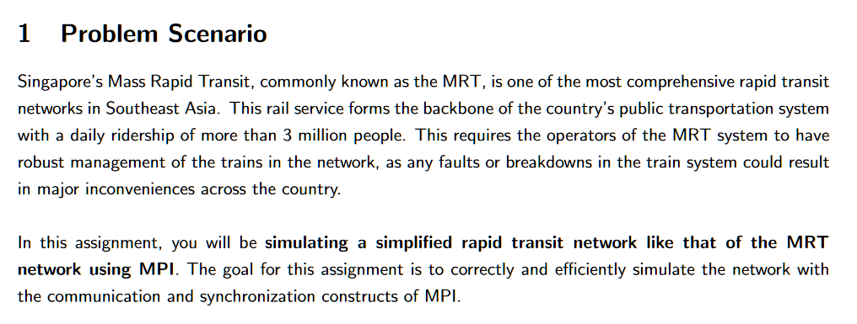
Assignment 3
You don't have to start on it now, but please at least take a look by the end of this week, so that you can ask me any questions for clarification early on 🥲.
Notes:
./generate_test_output.sh 1 1 1 1 tests/dipsy.in
rm logs/*.slurmlog;sbatch config1.sh 1 1 1 1 tests/dipsy.in

Slide 48
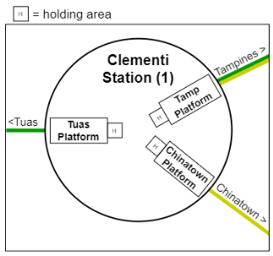
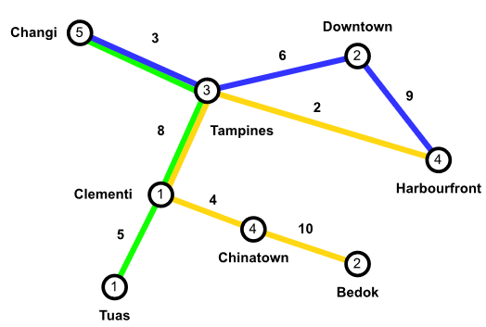
Quick overview of the example

Slide 49
General MPI tips from me
Starting on a naïve sequential solution first may not be the ideal strategy this time, it's not trivial to convert a sequential program to an MPI program.
However, if you want to test whether you have the correct idea on how to solve the assignment, you can do so to better understand the problem first.
Think about what kind of work you want to distribute among all the processes to process, and then think about the data you need each process to pass from one to another.
Master the use of MPI collective communication functions. That includes Gather, Gatherv, Scatter, Scatterv, Alltoall, Alltoallv.
Minimize the size of data being sent among the processes. Do not send strings (e.g. station names) around the network. For this assignment, sending structs of ints should be sufficient.
(another small hint: size_t is 8 bytes on a x86_64 architecture, while int is only 4 bytes).

Slide 50
Admin & Feedback
Feedback exercise is open now (https://blue.nus.edu.sg/Blue/)
Canvas should already be yelling at you to do so in the past week.
Next week is Tut 6 + Lab 6
Topic: Interconnects + Performance Measurement
Attendance is still taken for Tut 6, but Lab 6 is optional submission.

